Slide 1
UBER SUPPLY DEMAND GAP
Name: Rahul Kumar
Email: Rahul.cs068@gmail.com
Ph: +91-9538109454

Slide 2
Problem Statement
Uber is facing issue some challenges with cancellation and non-availability of cars, which leading them to financial losses. The issue is mainly appearing from travelling to and from Airport & City
The aim of analysis is to identify the root cause of the problem (i.e. cancellation and non-availability of cars) and recommend ways to improve the situation. As a result of this analysis, will present the root cause(s) and possible hypotheses of the problem(s) and recommend ways to improve Uber challenges.

Slide 3
Problem solving methodology
Problem Understanding
Data Gathering
Data load from given CSV file
Data Cleaning
Remove NULLs rows
Data type issue
Derived Columns
Data Analysis & Visualization
Frequency of requests
Time slots
Result
Overall conclusion
Data Understanding
etc…
Supply demand analysis
Uber problem statement
Data dictionary
Recommendation
Suggestion & Improvement points

Slide 4
Data Exploration
A masked data set with trip details is provided for analysis
6745 rows, 6 attributes
2 Character feature, 4 numeric feature
Data set contains 6 attributes associated with each request made by a customer :
Request id: A unique identifier of the request
Time of request: The date and time at which the customer made the trip request
Drop-off time: The drop-off date and time, in case the trip was completed
Pick-up point: The point from which the request was made
Driver id: The unique identification number of the driver
Status of the request: The final status of the trip, that can be either completed, cancelled by the driver or no cars available
Based on the problem statement, we should focus on pickup point, status and driver id.

Slide 5
Data Cleaning
Possible data inconsistencies:
Uniqueness of Request ID
NA values in the columns
Data consistency
Data type
Etc…
Date fields values are not consistent, are separated by “/” and “-”, Make this consistent for ease of data analysis
Request time stamp is not in one single data type, converted it to date time format

Slide 6
Data Preparation
Derive new variables which will be useful for analysis
tripDuration -- difference between drop and request time
reqYear -- extract Year from Request timestamp
reqMonth -- extract Month from Request timestamp
reqDay -- extract Day from Request timestamp
reqHour -- extract Hour from Request timestamp
reqMinute -- extract Minute from Request timestamp

Slide 7
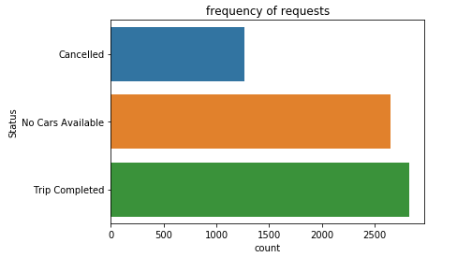
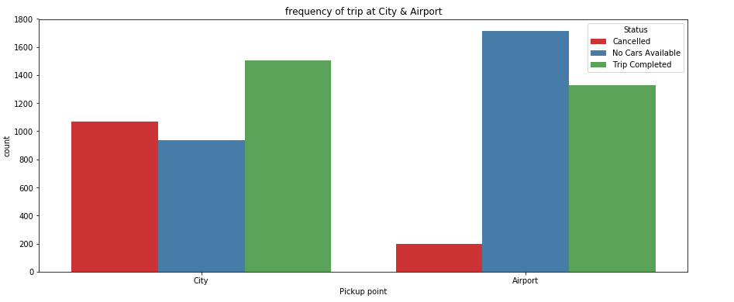
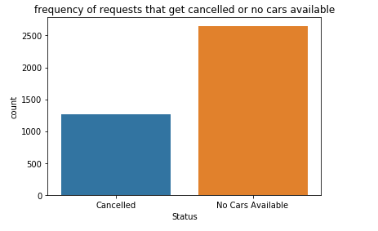
Request Analysis
Frequency of trip cancellation and no availability of cars from 'City to Airport' and 'Airport to City'

Slide 8
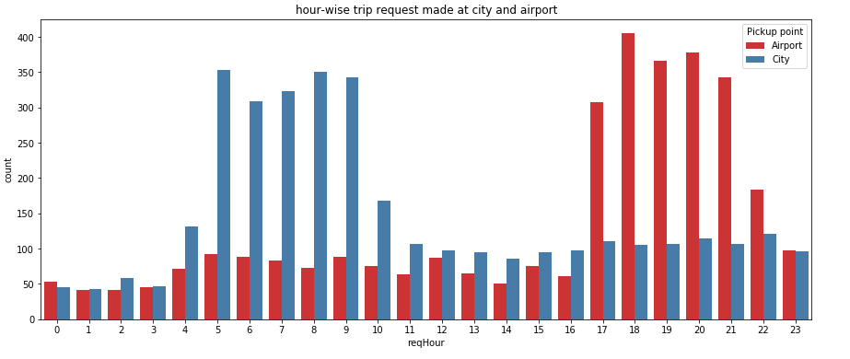
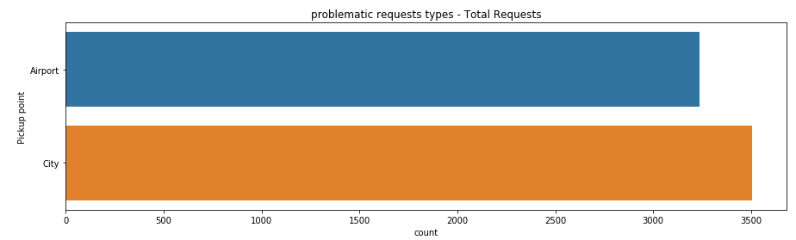
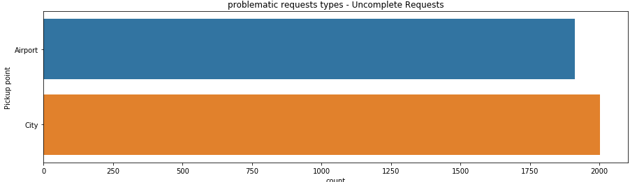
Pickup Point Analysis
The most problematic types of requests
City to Airport
Airport to City

Slide 9
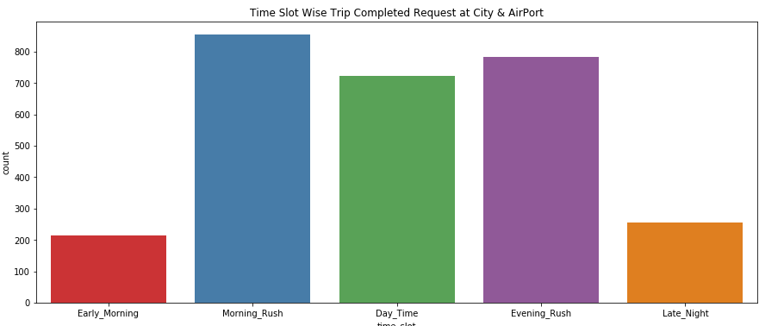
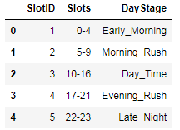
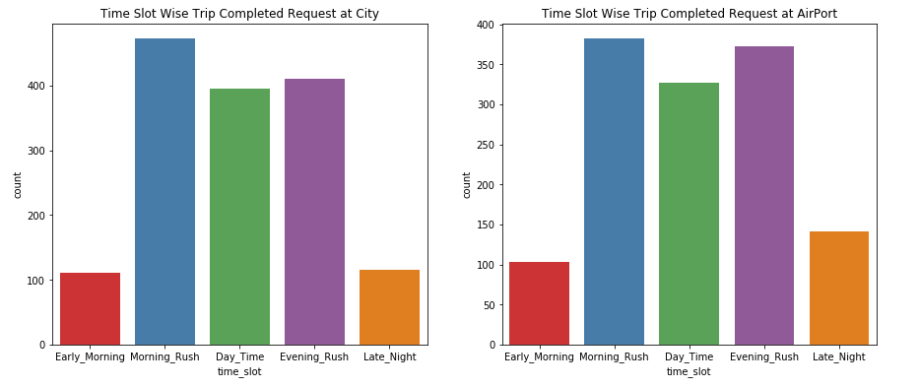
Time Slots Analysis

Slide 10
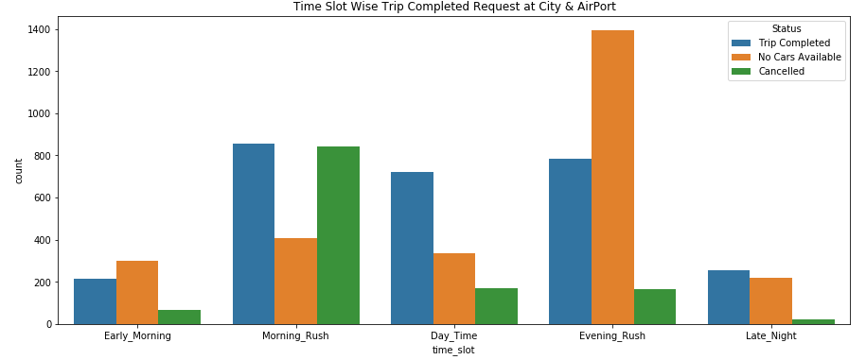
Time Slots Analysis
Time slots when the highest gap exists
from hour 5-9 and 17-21, more deviation between supply and demand – Morning Rush & Evening Rush

Slide 11
Time Slots Analysis

Slide 12
Time Slots Analysis

Slide 13
Conclusion
Based on the analysis done in the previous slides, the following conclusions can be drawn:
Since the constraint on the investment amount set by Spark Funds is 5 to 15millionUSD, the funding type that will be best suitable is ‘Venture’ type. It is clear from the results that Venture type companies are most sought after for investments.
The other constraint set by Spark Funds is to choose only the English Speaking Countries. The results show that the Top 3 countries where most of the investments are being done as a Venture type are USA, UK and India. Hence, Spark Funds may choose one or all among these three countries for the investment.
The Top 3 sectors in the above mentioned Top 3 Countries are as follows:
Looking to all considerations, Spark Funds can select either of top countries USA, GBR or IND respectively with best investment sector options as corresponding sectors for investment e.g. ‘Others,’ ‘Social, Finance, Analytics, Advertising’, ‘Cleantech/Semiconductors’…
*This conclusion is as per the data considered for end to end analysis.
USA
Others
Social, Finance, Analytics, Advertising
UK
Others
India
Others
Cleantech/Semiconductors
Cleantech/Semiconductor
Social, Finance, Analytics, Advertising
News, Search & Messaging's
Social, Finance, Analytics, Advertising

